Slide 1
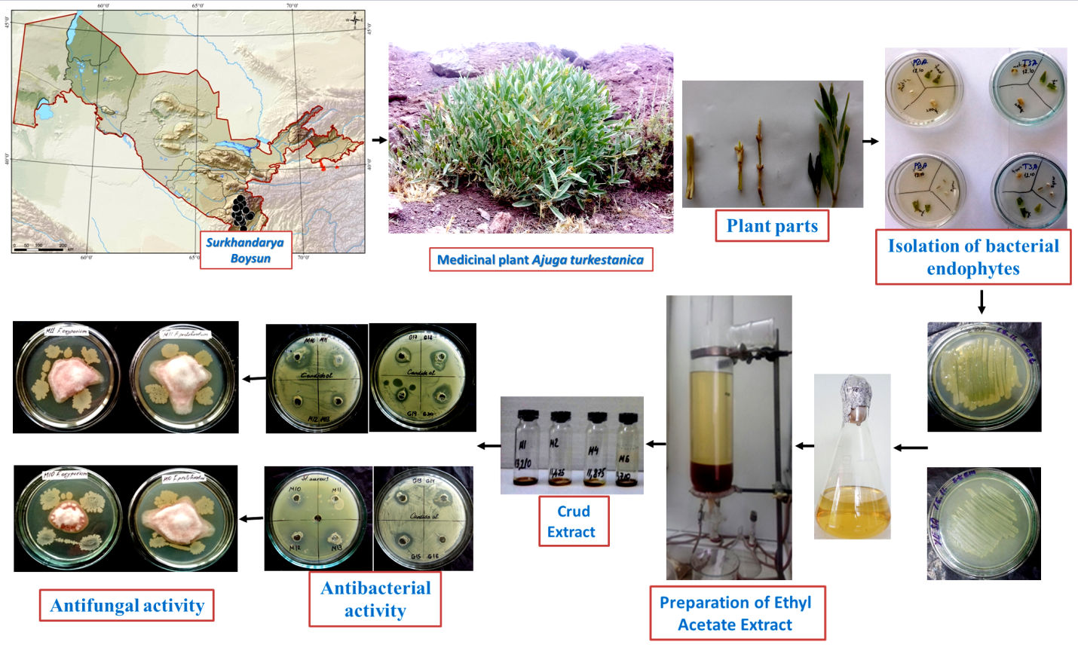
Graphical abstract.

