Slide 1
Supplementary Figures
Supplementary Fig. 1. The meteorological stations affecting Wadi Mehassar catchment area and their relative weight using Thiessen Polygons Method.

Slide 2
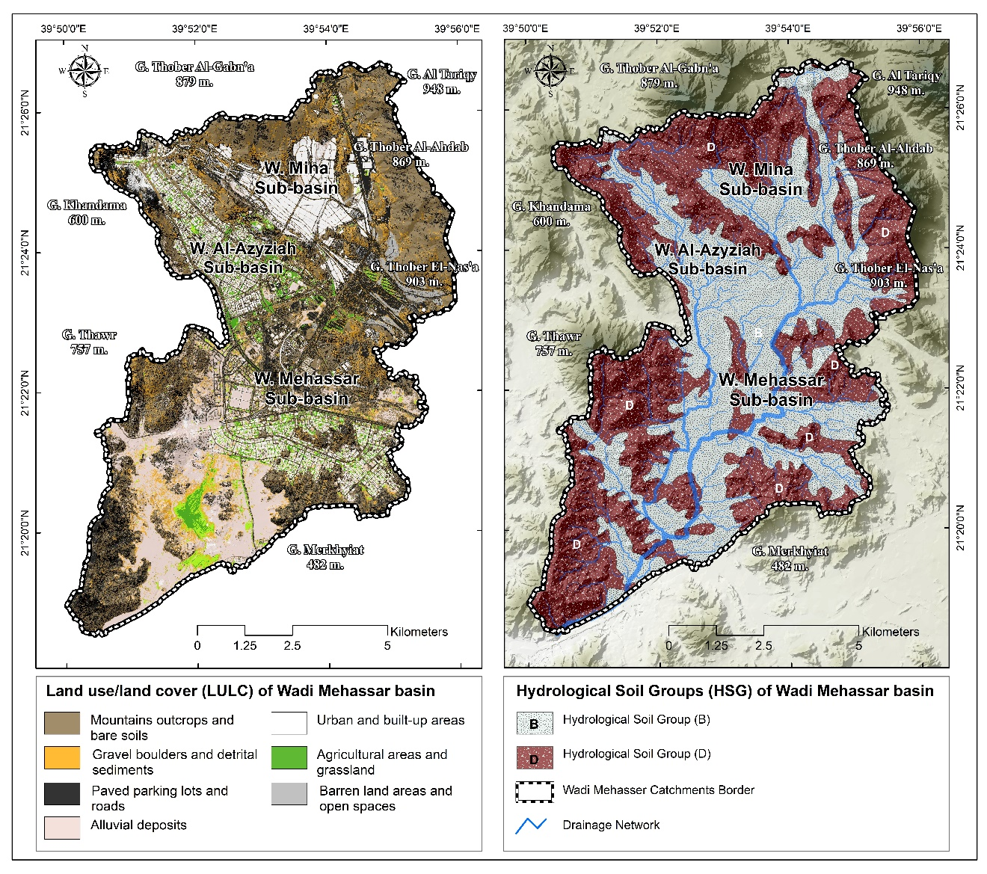
Supplementary Fig. 2. (a) The Land Uses/Land Cover (LULC) map delineated from the satellite data, (b) The Hydrological Soil Group’s (HSG) map delineated from the geological data for Wadi Mehassar basin.

